Slide 1
Natural Language Processing
WKSP 420 Module 3, Lesson 1
Notes:
Welcome to the module on Natural Language Processing. Here we’ll discuss the basic theory and parts of NLP. But know that NLP is a huge topic and a very active area of research. So we’ll only be able to cover a little bit in this course.

Slide 2
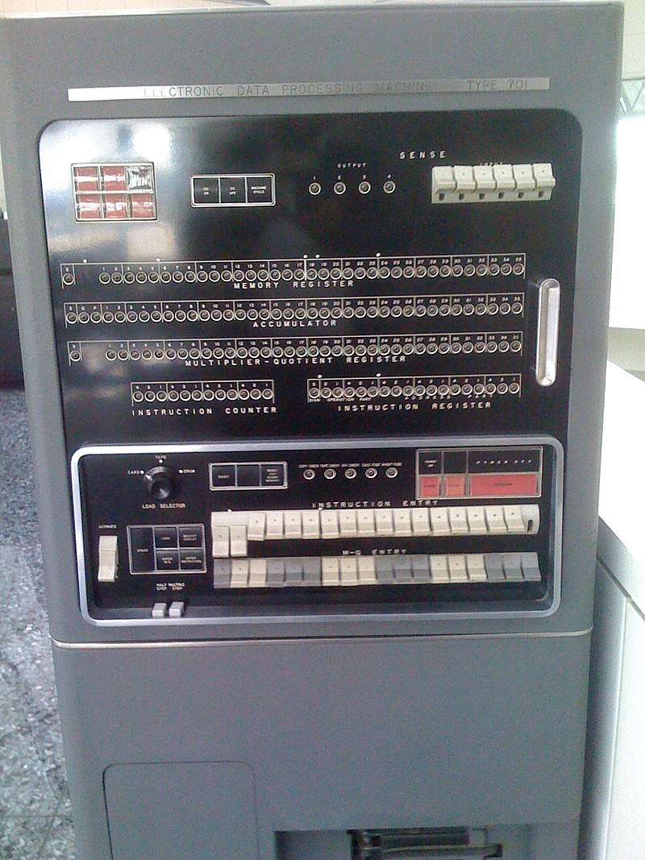
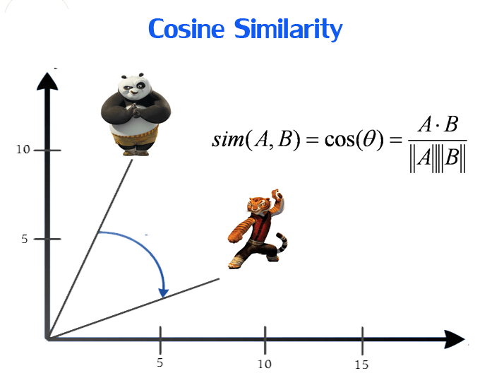
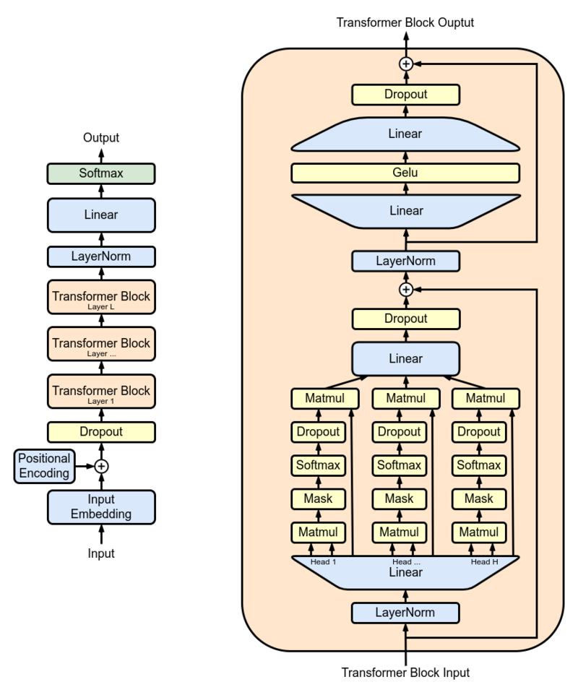

Some History
1954 Georgetown-IBM Experiment
1980’s – Statistical Machine Learning and WWW
2010’s – Deep Learning
Notes:
The field of NLP is thought to have started in the 1950’s when a Georgetown-IBM experiment sought to translate 60 Russian sentences into English. It was a rules based system, consisting of 6 grammar rules, 250 lexical items (words). Translation was carried out on the IBM 701 computer shown here. The algorithm would compare a Russian word to possible English words and choose the best one based on the rules.
See the following source for more details: Ornstein, Jacob (1955-10-21). "Mechanical Translation: New Challenge to Communication". Science. 122 (3173): 745–748. doi:10.1126/science.122.3173.745. ISSN 0036-8075. PMID 17820208.
Early experiments were rules and template based. Linguists and language experts defined patterns and rules of how a word or phrase in one language should be translated into another word or phrase in another language, or with templates to extract information from texts. The advantage here is that these rules are based on expert knowledge. However, this is not scalable and doesn’t work for real life where we can say the same phrase in many different ways.
In the 1980’s statistical approaches were developed for NLP. Here, algorithms observed the language or languages and analyzed them statistically to estimate the probability of a NLP outcome. This allowed machines to learn the rules of language instead of relying on experts. This was more scalable because we had better computing resources at this time. Also, in the 1990’s we had the internet revolution and this opened up a ton of more data to train these ML algorithms on so they could learn language rules that applied to the general public.
Now we’re in the deep learning era where machine learning has evolved into very complex algorithms that are able to learn on much longer strings of text across many large documents. We sacrifice transparency when we use these very large models because they are way too complex for human understanding. But the results give us some clue on whether they are learning correctly or not.
IBM701 Figure by Dan - Flickr: IBM 701, CC BY 2.0, https://commons.wikimedia.org/w/index.php?curid=13301780
GPT figure By Marxav - Own work, CC0, https://commons.wikimedia.org/w/index.php?curid=127066752

Slide 3

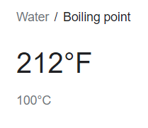


Information Search
Notes:
Let’s go over a few different applications of NLP. One that we’ve gotten very used to is searching for information on the web or other applications. These 3 examples show different phrases that I used that gave the same result. The NLP algorithm that Google is using needs to be able to understand that the 3 phrases mean the same thing as far as the user is concerned and need to have the same result.
In this case, the search engine is finding the keywords from the sentence and using those to perform the query. It can do this by understanding grammatical rules to determine what is the subject of a sentence, and also by filtering out unimportant words from the sentence. Then there might be a lot of pages with one or more of these words – the algorithm needs to find the ones that match the most closely with the search query so that the meaning of the query is preserved. We went over one similarity metric in the recommender systems module – cosine similarity.
Also as a side-note, consider that there’s a recommender engine running on a search site too that recommends the top sites that are most likely to have the result your query is looking for.

Slide 4
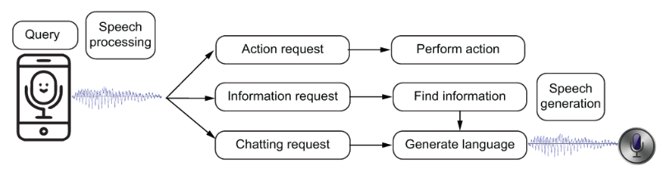
Virtual Assistants
“Getting Started with Natural Language Processing”, Ekaterina Kochmar
Notes:
Virtual assistants take action based on what they understand the user is asking. Let’s set aside the speech to text portion of the process and start after the virtual assistant has the text of the user query.
At this point, it takes a similar approach to the browser that we saw before: it needs to parse out the keywords of the query. It then takes a further step where it executes an action based on what it understands the user is asking. For example “call my spouse” means it needs to focus on the action “call” so that tells it to use the phone app, then look up “spouse” in the contacts, and then start the call.

Slide 5
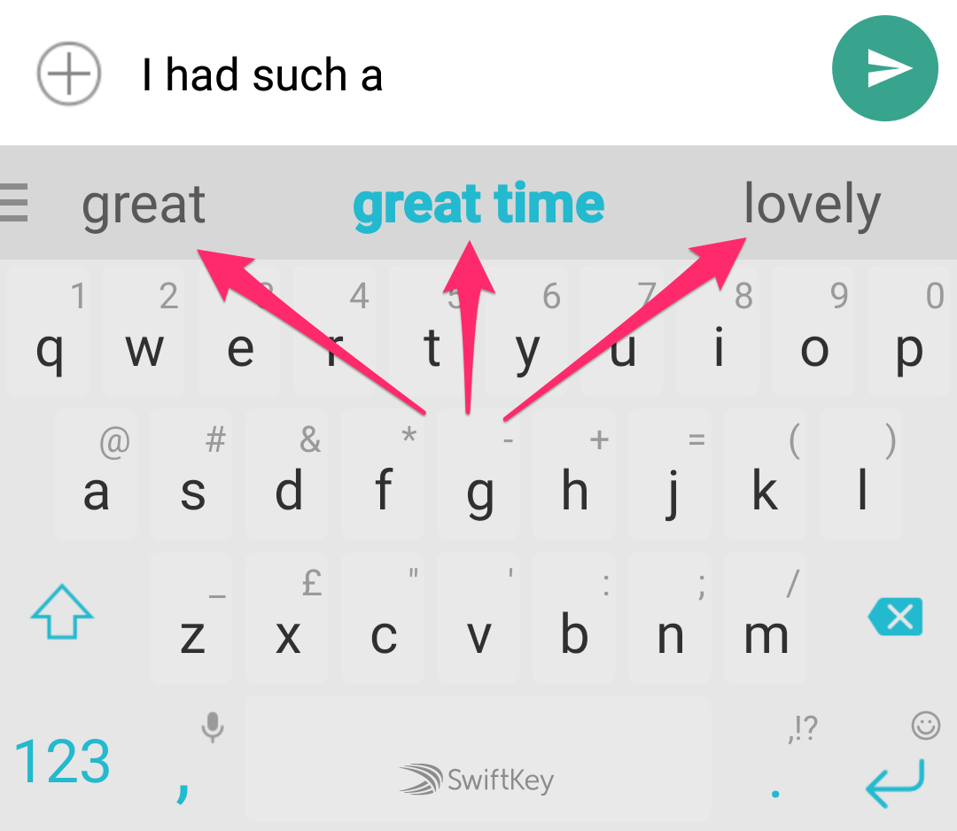
Text Prediction and Language Generation
Notes:
Getting more advanced, we can also have NLP for text prediction and language generation. This is really the benefit of deep learning models because they are able to see patterns in longer sentences which enables them to predict good candidates for next words based on similar sentences they have trained on in the past.

Slide 6
NLP Core Concepts
Text
Filtering
Train ML
Tokenize
Notes:
Let’s now turn our attention to the the core concepts of going from unstructured text to a training NLP model.
These four stages are fundamental to all of the applications we have seen so far. Some of this we practiced in DSS 320 when we were going over Recurrent Neural Networks.
Your input is a dataset of unstructured text. Each observation will have a sequence of words, and each sequence can be of different lengths. Think about a dataset of text messages – each one can be of different length. That has to be converted to a numerical format where each observation is of equal length so that a machine learning algorithm can use it.
Then you’ll do some filtering. In most cases, you’ll want to remove any punctuation because for most applications they don’t contribute to the machine learning algorithm’s understanding of the text. You’ll also need to remove stop words that don’t point to the main message of the text. These are common words such as “the, a, an, is, are, he, she, my, that” etc.
Next, you need to convert the strings that the words are represented as into tokens which are numerical representations of the words. For example, you could create a new column for each word and put a 1 if that word was present in the sentence, and 0 if absent.
Then you train your machine learning model on these tokens.

Slide 7
ChatGPT: Tell me a Joke
Why did the chicken cross the playground? To get to the other slide!
Why did the scarecrow win an award? Because he was outstanding in his field!
😂
Notes:
Why do we need to spend so much time pre-processing the data? Because think about how observations of text are in their raw format. They are strings of varying length which is not something that a very math-heavy machine learning algorithm is able to cope with. It also doesn’t understand the relationship between one word and another. So we spend a lot of time and effort trying to represent similar words as similar tokens.

Slide 8
Filtering
Puncutation !@#$%.;()[]
Stop Words for, a, at, the, by, that, but
Stemming: using, used, uses → use
Capitalization: Data Science → data science
Keywords = Signal
Everything else = Noise
Notes:
For more simplistic models you can usually do a fair amount of filtering because the model is not trying to understand the full meaning of the sentence. For example, a spam filter might just be trying to figure out if the text message is spam or not. In those case, start with filtering punctuations first.
Then remove stop words. These are very common words and because they show up most in sentences of a language while not specifically describing the subject or verb, they tend to throw your models off because their presence is so much higher than other words in the language. If you keep them in, your model might give them high importance due to their frequency and that would throw off your accuracy.
You can use a procedure called stemming, where you reduce different words to their same base word. So “used, using, uses” turn into “use”
Also, remember that to a computer, words that start with a capital letter are different than words that are all lower case. If that doesn’t matter to your application, such as for a spam filter, then move all your words to lower case.
The point of all of this filtering is to remove the number of unnecessary variations of words.

Slide 9
Tokenize
Cat chases mouse
[5, 20, 6]
Notes:
In it’s simplest form, you can think of tokenization as the process of converting these strings of words into vectors that can be analyzed for their statistical properties.
Tokenization must follow the condition that similar sentences have similar Tokens. This is fundamental to all Natural Language Processing, and I will footstomp this several times throughout these lectures. All of the work of NLP in finding similar sentences and phrases requires that similar sentences result in similar tokens.

Slide 10
Bag of Words
 | Cat | Car | Chased | Dog | Mouse
Cat chased the mouse | 1 | 0 | 1 | 0 | 1
Dog chased the car | 0 | 1 | 1 | 1 | 0
Totally different sentence | 0 | 0 | 0 | 0 | 0
Notes:
Let’s go over a few different tokenization methods. Bag of Words is a very simple tokenization method where each word is turned into a column and there is a 1 if that word is present and 0 if that word is not present.
Looking at the table, if you consider the vectors formed by the bag of words, there is much more commonality between the first two sentences than the third one. What’s not shown here is that the number of columns extends to the right to accommodate the words in the 3rd sentence. I don’t have enough screen space to show every word in this dataset.
So that is a downside to this methodology. You need to create a separate column for each word in your dictionary. Where Dictionary is the complete set of words in your dataset. This resulting matrix can be quite large and also very sparse if the sentences are fairly independent of each other, which is mostly the case with language.

Slide 11
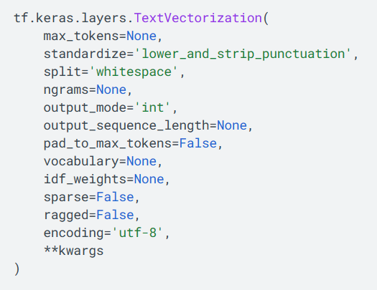
Keras TextVectorization
Notes:
Keras offer some pretty powerful tokenizers, one of which is the TextVectorization function. I’ll cover a few of the key features.
This function enables more dense tokenizing. In the Bag of Words, we represented the presence of each word as a 0 or 1. Because we only had 2 choices, we needed a much longer vector to represent all the words in our dictionary. However, if you use more numbers than just those 2 choices, we could represent the dictionary with much fewer columns.
So here, we see a parameter where you get to define how many tokens you want. If you set it to None, then you’re removing the upper limit on the number of tokens. This might be good for a small vocabulary. But often you don’t need every word in your dictionary for the application you’re going after. For example, if you’re doing semantic classification or training a spam filter, you can determine the class with just a handful of the words in the observation. So you can save some processing power by defining an upper limit.

Slide 12
Bag of Words
 | Earth | Wind | And | Fire | Michigan
Earth Wind and Fire | 1 | 0 | 1 | 0 | 1
Fire and Earth Michigan | 0 | 1 | 1 | 1 | 0
Notes:
Here is an example. In bag of words, we can represent these words as a 0 or 1 depending on whether they are present.

Slide 13
TextVectorization
 | Earth | Wind | And | Fire | Michigan
Earth Wind and Fire | 2 | 3 | 4 | 5 | -
Fire and Earth Michigan | 5 | - | 4 | 2 | 1
Notes:
With Keras TextVectorization, each word is represented as a number. Then the vector for the sentences is the list of numbers that represent each word.
So Earth Wind and Fire is the vector [2,3,4,5]
Fire and Earth Michigan is the vector [5.4.2.1]
How do you choose how long your text vector should be? In the ideal case, we want the text vector to be as long as the longest sentence. However, sometimes you have some outliers in your data. For example, in the lab, we’ll see that most text messages are less than 100 words in length, but there are a few text messages that are over 500 words in length, and one that’s 900. It depends on your application. In the lab, we’ll be doing simple binary classification, so in that case, we don’t really need all the words in a sentence. So we can choose a text vector length that’s smaller than the longest sentence in your dataset.

Slide 14
Keras TextVectorization
Notes:
There is a built in function to convert to lower case and remove punctuation. You can also do one or the other if you wish.

Slide 15
Keras TextVectorization
Notes:
How do you want to split the text. The most common case when we’re writing sentences is to separate the words with a space, which is the default.

Slide 16
Keras TextVectorization
Notes:
The size of the output vector. If you set it to None by default, then the tokenizer will determine the number of tokens needed for your dataset. That’s probably a good option. We’ll practice this in our dataset and see what it chooses.

Slide 17
Keras TextVectorization
Binary
Int
TF-IDF
Notes:
You can output to binary which would give you Bag of Words vectorization where every word is a 0 or 1 token. You can output as an integer where the value can be from 0 to your Max_token value.
Now I also want to go over 1 more term when it comes to text vectorization. The output mode here outputs tokens to “integers”. However, if you look at the documentation for this method, you’ll see that it is also able to output in a mode called “TF-IDF”. This is an important term in Natural Language Processing, and so I want to explain what it is because you might encounter it if you work in this field.

Slide 18

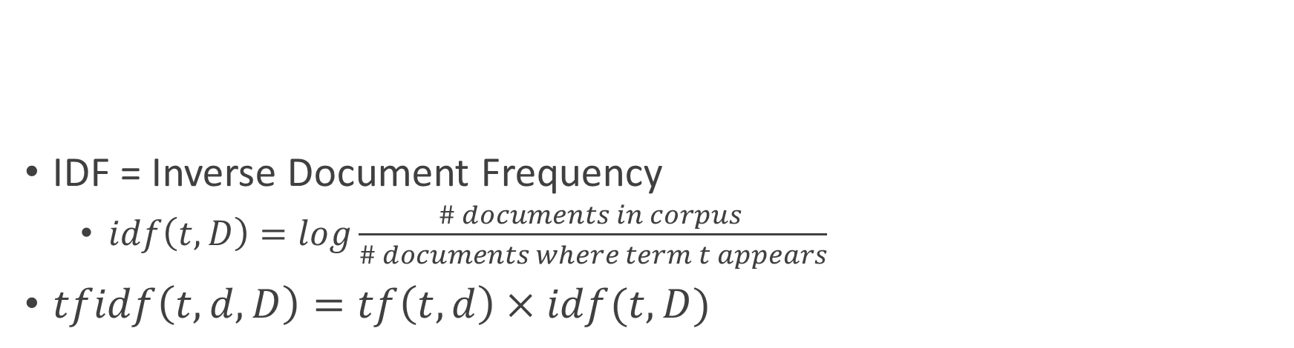
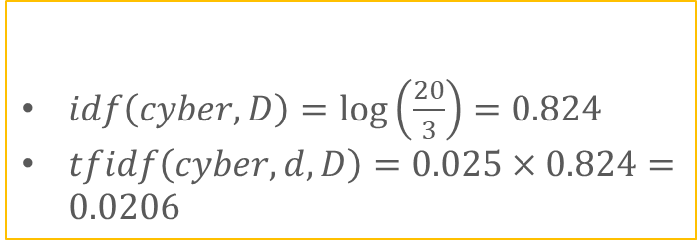
TF-IDF
TF = Term Frequency
$tf\left(t,d\right)= \frac{\# of t in document d }{\# of words in document d}$
IDF = Inverse Document Frequency
$idf\left(t,D\right)=log\frac{\# documents in corpus }{\# documents where term t appears}$
$tfidf\left(t,d,D\right)=tf\left(t,d\right)×idf(t,D)$
$tf\left(cyber,d\right)=\frac{5}{200}=$0.025
$idf\left(cyber,D\right)=\log\left(\frac{20}{3}\right)=0.824$
$tfidf\left(cyber,d,D\right)=0.025×0.824=0.0206$
Notes:
TF-IDF stands for Term Frequency-Inverse Document Frequency. The reason that this is popular is that it’s a good way of finding good keywords when you have a large number of documents.
TF is the number of occurrences of word t in the document d divided by the total number of words in document d
Bigger if there are a lot of times word t shows up in the document, or if the number of words in document is small. So a relative importance.
Shown here as an example is a chat-gpt generated paragraph on cybersecurity threat to the United States. The term frequency for cyber in this document is then 0.025.

Slide 19
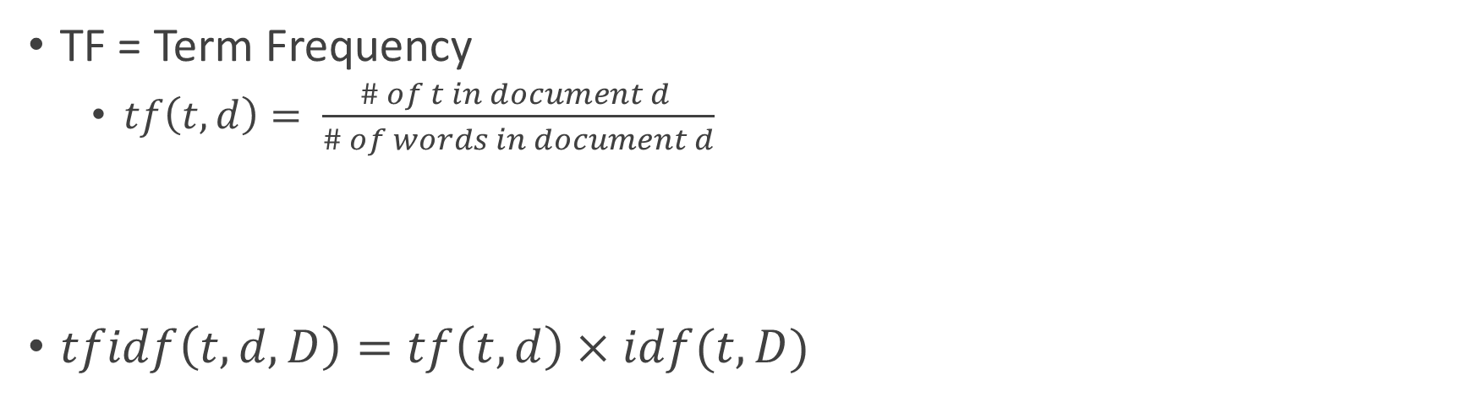
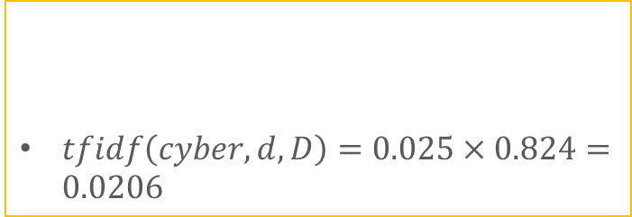
TF-IDF
TF = Term Frequency
$tf\left(t,d\right)= \frac{\# of t in document d }{\# of words in document d}$
IDF = Inverse Document Frequency
$idf\left(t,D\right)=log\frac{\# documents in corpus }{\# documents where term t appears}$
$tfidf\left(t,d,D\right)=tf\left(t,d\right)×idf(t,D)$
$tf\left(cyber,d\right)=\frac{5}{200}=$0.025
$idf\left(cyber,D\right)=\log\left(\frac{20}{3}\right)=0.824$
$tfidf\left(cyber,d,D\right)=0.025×0.824=0.0206$
Notes:
IDF is the log of the total number of documents in the corpus divided by the number of documents in which the word t appears.
Log so that it doesn’t grow quickly
“Inverse” because it gets smaller if there is a large count of term t across a smaller number of documents. So relative frequency of term t across the corpus gives a smaller idf value
Intuitively, this means that if a word is unique to one or a small handful of documents in the corpus, then it is more interesting. If it is common in all the documents, then it is not interesting as a word that is more rare. A rare word is better for building a query than a common word.
In our example, if we have 20 documents and the term Cyber appears in 3 of them, then IDF here is 0.824.

Slide 20


TF-IDF
TF = Term Frequency
$tf\left(t,d\right)= \frac{\# of t in document d }{\# of words in document d}$
IDF = Inverse Document Frequency
$idf\left(t,D\right)=log\frac{\# documents in corpus }{\# documents where term t appears}$
$tfidf\left(t,d,D\right)=tf\left(t,d\right)×idf(t,D)$
$tf\left(cyber,d\right)=\frac{5}{200}=$0.025
$idf\left(cyber,D\right)=\log\left(\frac{20}{3}\right)=0.824$
$tfidf\left(cyber,d,D\right)=0.025×0.824=0.0206$
TF-IDF gives more importance to terms with high relative frequency in some documents but are still rare across the corpus of all documents.
Notes:
The output of the TextVectorizer function in Keras can be in tf-idf if we had a large number of documents. If you have a dataset of text messages, then each text message can be treated as a “document” and you can get an tf-idf score for each word in your dictionary.
- In our example, the tfidf of Cyber over a corpus of 20 documents and for document d is 0.0206.

Slide 21
RNN Basics
RNNs use a memory layer (h)
H₀
X₀
Notes:
Now that we’ve covered how to transform unstructured string text into structured tokens, let’s get into model building. You can use many different types of classifiers once you have your text tokenized. We’ll go over several different classifiers here next.
We learned about Recurrent Neural Networks in DSS 320. They are useful for sequential type data which applies to text where the words occur one after another.
As a refresher, in an RNN, one part of the input arrives and goes to a hidden state, which is like a memory.
So the first step in the RNN is for the first piece of information X_0 to enter into a memory layer called H_0. Think of X_0 as the first word in your sentence.

Slide 22
RNN Basics
Current stage builds from past stages
H₀
H₁
X₀
X₁
Notes:
Then, in the next layer, there are 2 inputs – the first is the next element of the sequence X1, and then also the information from the last memory stage H0.
So the output of H1 is now the product of the 2 pieces of input X0 and X1 and the prior memory H0.

Slide 23
RNN Basics
End with a Dense Output Layer for decision
H₀
H₁
. . .
H_{n}
Output
(Dense)
X₀
X₁
X_{n}
Notes:
We continue this pattern with the sequence of inputs until we reach the final stage H_n with input X_n. From there we output to a densely connected output layer to get our prediction.
So each word in our sentence can be an input.

Slide 24
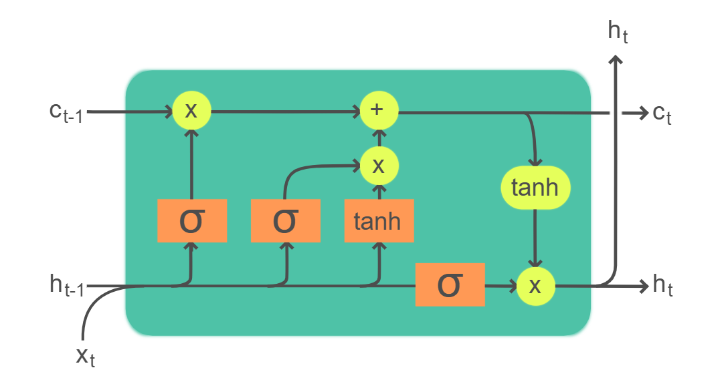
LSTM
Input Gate
Memory cell updated
Forget Gate
Memory cell reset
Output Gate
Current State more visible to next state
Cell State
Hidden State
Notes:
Another related classifier are LSTMs. These are modified RNNs that have both long and short term memories. This is helpful in processing sequences where meaning can be interpreted by words and their direct neighbors, as well as words that come much earlier or later in the sequence.
-------------- Explanation -------------------------------
LSTMs are a type of gated Neural Network. It stands for Long Short Term Memory
This consists of not just the hidden memory h, but also of the cell state c. Think of the hidden state as dealing with just the previous memory state, while the cell state is an aggregation of all the previous memory states. So the cell state can deal with more long term memory, while the hidden state can deal with the short term memory.
There are 3 types of gates for the cell state:
The Input Gate determines how much of the memory is updated from the previous state
The Forget Gate determines how much of the past memory you want to forget
The Output Gate determines how much of this current memory state you want to output to the world
These gates and the cell state allow the LSTM to determine which words are more important in a sentence and which ones are less important.
Source: https://youtu.be/QciIcRxJvsM
Also: https://medium.com/analytics-vidhya/lstms-explained-a-complete-technically-accurate-conceptual-guide-with-keras-2a650327e8f2#:~:text=As%20you%20can%20see%20in%20the%20diagram%2C%20each,get%20modified%20by%20the%20next%20time-step%20yet%20again.

Slide 25

Spatial Data → CNN
Spatial Data: Learning from the position of one pixel to its neighbors
Convolution
Pooling
Output
Notes:
Interestingly, Convolutional Neural Networks which are great for spatial data such as pixels in an image have also been used for NLP applications.
It’s because you can represent words as strings and then you put those strings together to form a 2D matrix, which can be treated like pixels in an image that a kernel can learn.

Slide 26
Text
Tokenize
Embedding Layer
I
14
[1,2,3,4,5]
am
5
NN
[6,3,7,2,1]
Groot
1
[0,9,5,6,8]
Similar words should have similar embedding vectors
Notes:
So the text gets tokenized and goes to an embedding layer. This embedding is more than just breaking down one number into a vector. The vectors needs to be generated in a way that similar words have similar embedding vectors. The similarity can be measured through many metrics like the dot product or cosine similarity.
If you’re curious to know how to get these vectors to be similar to each other, know that we use a simple neural network with all the sentences to create the embedding vectors for each word.
A lot of times this embedding network is pre-trained on a large amount of text. For example, you can pre-train all the words in the Wikipedia text dataset and create vectors for every word. Then if 95% of the words in your specific use case are already contained in the Wikipedia text dataset, then you only need to create the embeddings for the remaining 5%.
This a good reference on embeddings. https://youtu.be/viZrOnJclY0?si=OZ2js482rad0XyZw

Slide 27
Output
Pooling
4 | 4 | 4 | 7 | 7 | 2 | 3 | 9 | 2
6 | 2 | 5 | 6 | 2 | 4 | 6 | 8 | 4
6 | 5 | 9 | 2 | 4 | 5 | 3 | 8 | 1
3 | 4 | 4 | 2 | 5 | 2 | 8 | 3 | 6
4 | 9 | 9 | 9 | 9 | 6 | 9 | 6 | 5
1 | 9 | 3 | 2 | 2 | 3 | 7 | 1 | 7
9 | 1 | 7 | 1 | 8 | 4 | 4 | 4 | 7
2 | 7 | 6 | 6 | 6 | 6 | 6 | 3 | 6
1 | 3 | 5 | 8 | 4 | 3 | 1 | 2 | 1
3x3 Kernel
Convolution
Pooling
5x5 Kernel
Convolution
Pooling
7x7 Kernel
Convolution
Embedding Layer
Notes:
Now you can turn your sentence into a larger matrix by setting the embedding layer and token size setting to a larger output size. Now you could turn your sentence to for example a 11x11 matrix. This is now similar to how an image is represented by pixel values and can be analyzed by a Convolutional Neural Network.
Then you can also use different kernel sizes to learn how words are related to closer to further neighbor words based. For example a 7x7 kernel might learn how one word is related to another word that comes 3 spots later in the sentence, while a 3x3 kernel might learn how one word is related to its immediate neighbor words.

Slide 28
Advanced NLP
Notes:
Now let’s get a little bit in to more advanced topics in NLP. This subject is extremely broad and complicated and often requires a lot of diverse talent and hard work to get a computer to Process Language in a Natural manner.
Mainly when we start talking about advanced NLP, we are considering applications where we need context of the text, where the algorithms needs to understand the meaning of longer strings of works, like phrases and sentences.
What I want you to get from this scenario is that many of these advanced tasks will likely require you to use commercial products that you tune for your application.

Slide 29

Scenario
You are tasked to create a system that can
read through a set of emails at a company
Find Relevant Meetings
Invite the key members

Slide 30
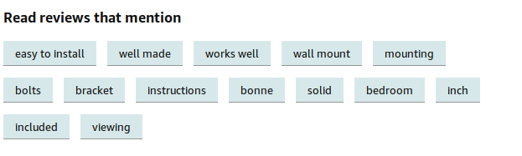
Key Phrase Extraction (KPE)
Notes:
Key Phrase Extraction is when the NLP algorithm can determine which parts of the sentence are the most important. For example, Amazon is able to pick out the most important phrases in the reviews of a product and provide those up front as a summary to buyers.
Image from Practical Natural Language Processing by Sowmya Vajjala, Bodhisattwa Majumder, Anuj Gupta, Harshit Surana

Slide 31
KPE Solutions
Fundamental Types of English Words
Nouns, Verbs, Adjectives, Adverbs, Pronouns, Articles, Prepositions, Conjunctions, Interjections
Dictionary can be ingested as a start
Phrase Structure Rules
Sentence → [Noun Phrase][Verb Phrase]
Noun Phase = [Article][Noun]
Verb Phrase = [Verb][Noun]
Many more rules
Notes:
First we use certain grammatical rules to break down the text into words and phrases. I know previously I said that using SME generated rules was a thing of the past, but we’re bringing it back now, at least for part of the process.
You would program various phrase structure rules into your KPE solution.
Notes: https://youtu.be/fOvTtapxa9c

Slide 32
Parse Tree
Sentence
Noun Phrase
Article
Noun
Verb Phrase
Verb
Prepositional Phrase
Verb
Preposition
Noun Phrase
Preposition
Article
Noun
The
Mongols
Rose
From
The
Leaves
https://youtu.be/fOvTtapxa9c
Notes:
With these rules you can break down a sentence into it’s component parts. Here, you might need to revisit the idea of stripping stop words and punctuation if that is now more important towards your understanding of a language
From here, you have 2 options. You can run a supervised algorithm if you have labelled datasets that identify the key phrases or not key phrase.
Or you can use an unsupervised algorithm, which is good if you have a large amount of text data.

Slide 33
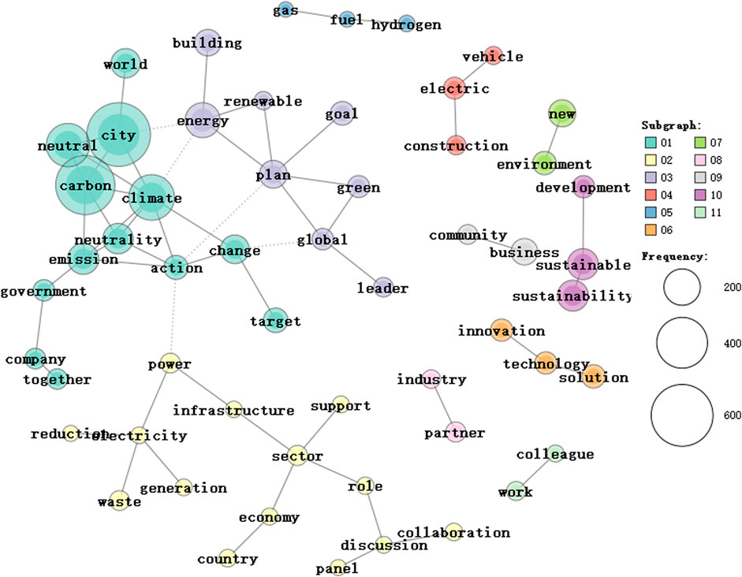
KPE Tools:
spaCy (Python library)
https://www.frontiersin.org/articles/10.3389/fenvs.2022.962367/full
Notes:
The unsupervised algorithm represents words and phrases in text as nodes in a weighted graph, where the words that are more connected get higher weight and are therefore more likely to be a keyword.
Common tools you can use to do that are included in the spaCy python library. This might get us key phrases from the emails, which might include words like “meeting”, “conference”, “workshop”, “meet-up”, “discuss”

Slide 34
Named Entity Recognition (NER)
Named Entity =
Names of persons
Locations
Organizations
Specialized strings
Money expressions
Dates
Products
Names/numbers of laws or articles
Etc.
Notes:
Named Entities refers to many things, not just the names of people or places.
(read the list) For our application we are interested in Names of persons, date, organizations, and locations for extracting meeting details.

Slide 35
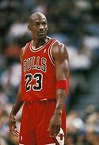


Named Entity Recognition (NER)
“We need to invite Michael Jordan to the meeting”
Notes:
Next you need to determine who to invite to meetings. This requires the computer to recognize names. This is harder that it initially seems.
If you have a co-worker named Michael Jordan, the computer needs to determine if Jordan is referring to the basketball start, a member of your team, or the country Jordan. Things that seem obvious to us are often very hard to program for a computer.

Slide 36
NER Solutions
Large Database of Named Entities
Grammatical rules
Find nouns → determine Named Entities from candidate nouns
Train ML Algorithm
Sequence classifier takes context into account
Context = Neighboring words and sentences
Requires labelled training set
Use pre-built models + domain specific heuristics
RASA, BERT, spaCy, AllenNLP, etc.
Notes:
To build an NER system, you could maintain a large database of people, places, and things – but this will never be a complete set.
You could provide an employee directory to start with for your meeting scheduler, and then tell the algorithm to search there first before looking out at broader sources.
You can use various grammatical rules like what we saw earlier to parse out nouns and then do a secondary step to determine which ones of those are Named Entities or people.
You can also train a machine learning algorithm. There are certain kinds of classifiers called sequence classifiers that take context into account. In NLP you need to understand the relationship between the words surrounding the target word to understand the context or meaning. One drawback of this is that you need labelled training data, which can be hard to find, though there are many open source datasets out there.
Finally, you can use pre-trained models. I will cover this more somewhat in some later slides, but there are very complex models such as GPT, BERT, LLAMA from Facebook, etc. that you can then tune to fit the text in your application. This is extremely powerful.

Slide 37


Relationship Extraction (RE)
RE is not necessary for our scenario
Once you know the Named Entities, you need to find the relations between them
Bob
Should attend
This Meeting
Sara
Notes:
For this scenario, knowing the named entities of the meeting should be enough to form a meeting invite. However, in more advanced NLP, you need to learn the relationship between the entities to really understand what the sentence means.
You can use a semi-supervised approach, where you hand-craft some seed relationships. Then you go through a large amount of training text to see which relationships in the data closely match those seeds. That’s why it’s semi-supervised. The latter step doesn’t find exact matches to the seed relationships, but allocates them based on those that are a closest match to the seed.
But RE is an AI Hard problem. You’ll get better results by using commercial solutions such as Watson and Azure, and others.

Slide 38
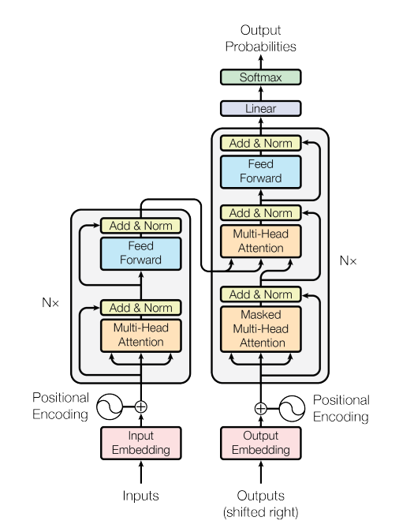
Transformers and LLMs
Attention is All You Need, Vaswani, et al (2017)
Very complicated structure
Notes:
As you can see, when NLP gets very complex, it is often best to use a commercial solution rather than create something from scratch. Recently, this has been taken to the extreme by using what are called Transformers. We’ll roll up our sleeves and get into the fundamentals of Transformers next, followed by how to use some open-sources transformer models in the lab.

